Slide 1
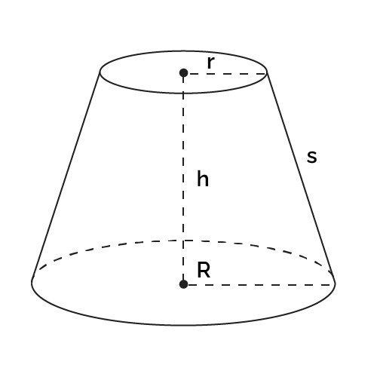

Modeling Tree Volume from Geometric First Principles
Jonathon Hirschi
October 10, 2022
SIAM Blitz Talk
Notes:
Line spacing + Page numbers

Slide 2
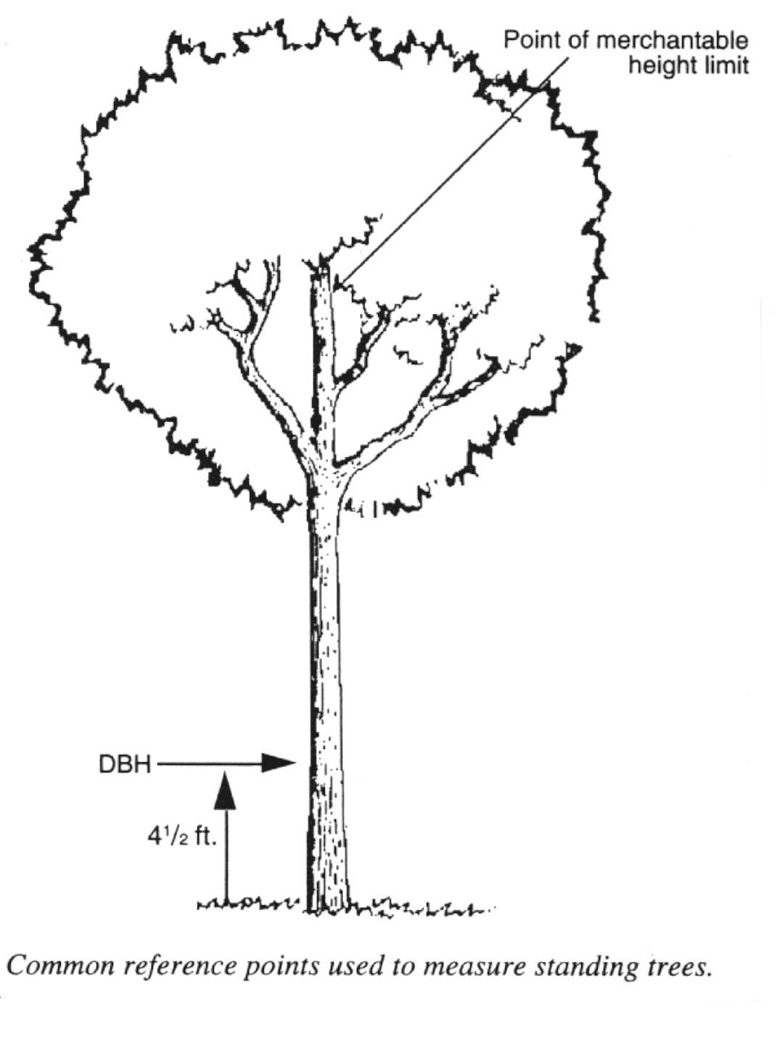
Background
Foresters collect measurements of tree diameter and height
Tree volume is estimated from these two observations
This is common in academia and industry, e.g. Forestry, carbon sequestration, etc.
Source: Ohio State University

Slide 3
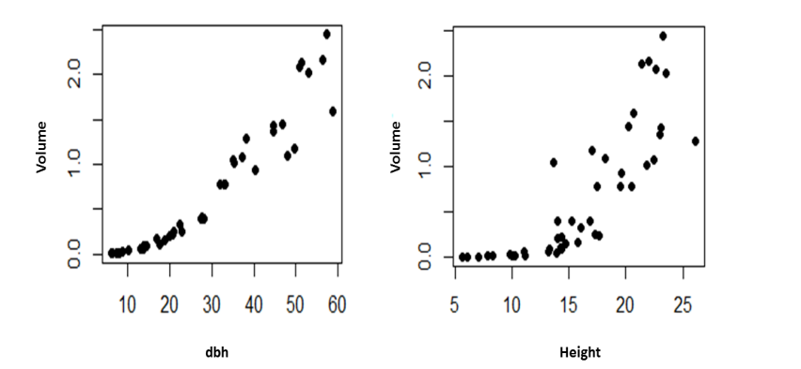
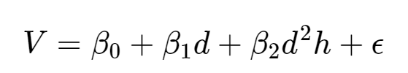
Modeling Tree Volume
Standard is Linear Regression
A 2017 paper compared many linear models and arrived at the following specification:
Source: Koirala et al. 2017
Note: 4 parameters

Slide 4
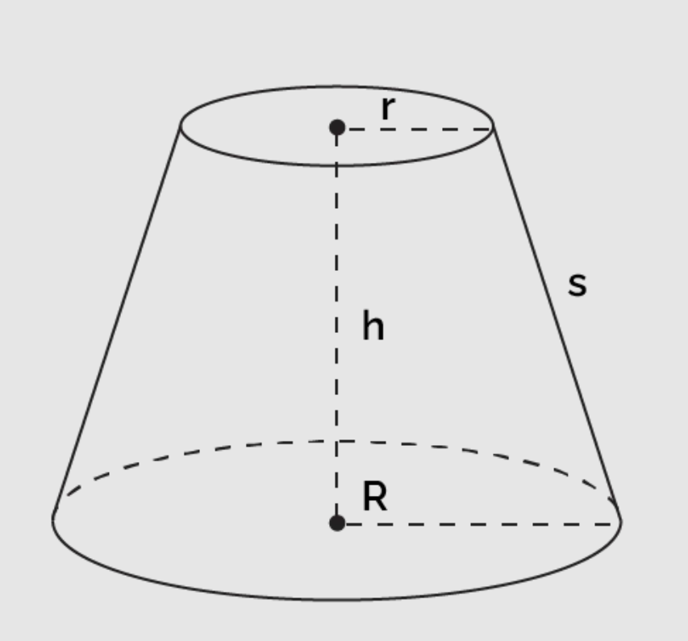
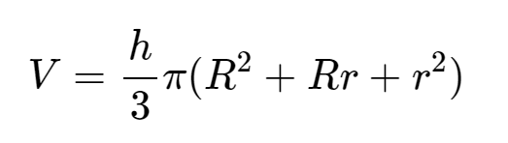
Model from Geometry
Consider the tree to be a truncated cone
Volume formula:
Top radius unknown

Slide 5

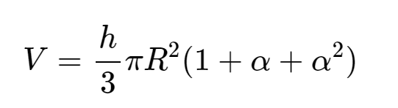
Model from Geometry
Upper radius is some fraction of the lower radius
Statistical model with just one unknown parameter:

Slide 6
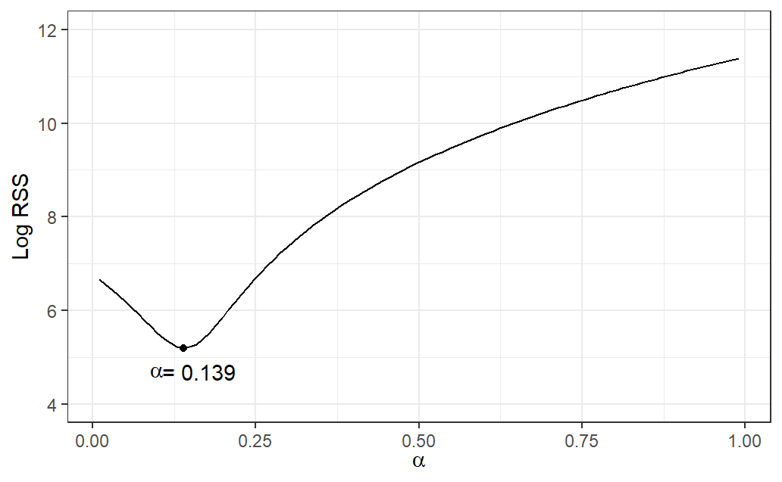
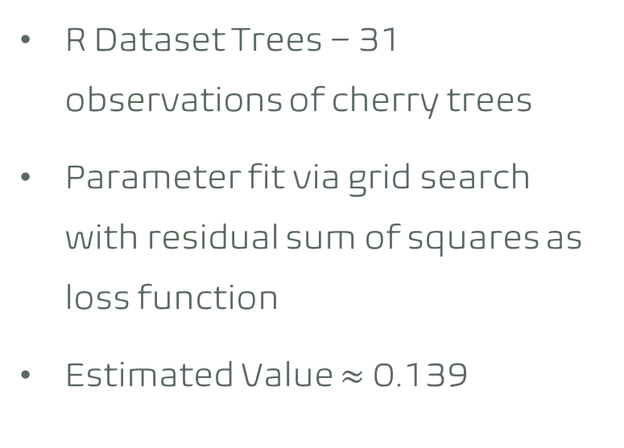
Trees Data Grid Search
R Dataset Trees – 31 observations of cherry trees
Parameter fit via grid search with residual sum of squares as loss function
Estimated Value $≈$ 0.139

Slide 7
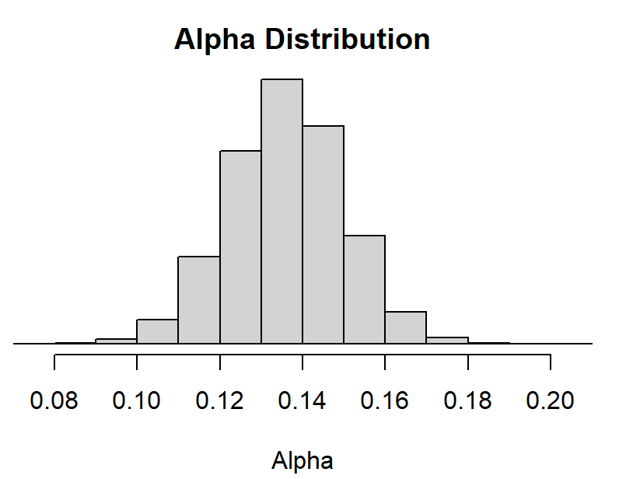
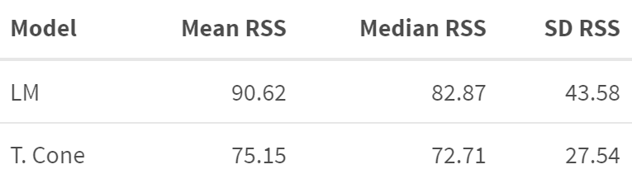
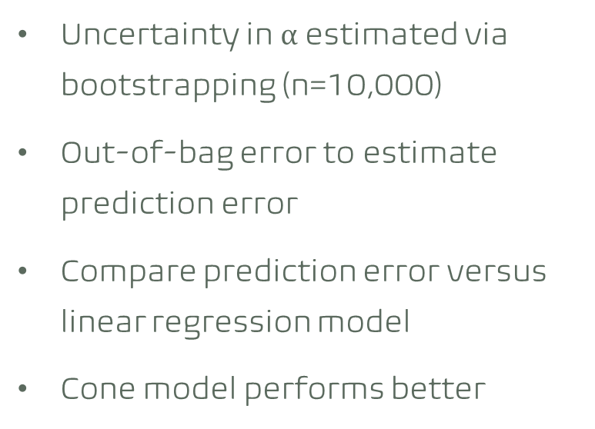
Bootstrapping Uncertainty and Accuracy
Uncertainty in $α$ estimated via bootstrapping (n=10,000)
Out-of-bag error to estimate prediction error
Compare prediction error versus linear regression model
Cone model performs better

Slide 8
Discussion
Statistical models can be built from physical first principles
The geometry models provides additional physical insight, e.g. estimate of surface area
Resampling and grid search allows for more creative modeling. We don’t have to know how to theoretically minimize (I tried…)
What other types of models can we build like this?

